Slide 1
Statistical Analysis
What do we with data?

Slide 2
Data
Story behind the data
How was it collected?
Independence of cases?
Documentation
Bad data
Missing data – how do we know
What do we do with all of these data?

Slide 3
When you lay eyes on an unfamiliar territory for the first time, it always makes sense to get an overview before venturing into the thick of it. An unfamiliar data set is like an unknown land.

Slide 4
Purpose of graphs
Exploration - there is a message in the data and the display helps us to learn what it is.
Communication - we know something and the display helps us to effectively tell others.
Decoration - the graph is pretty and enlivens the presentation.

Slide 5
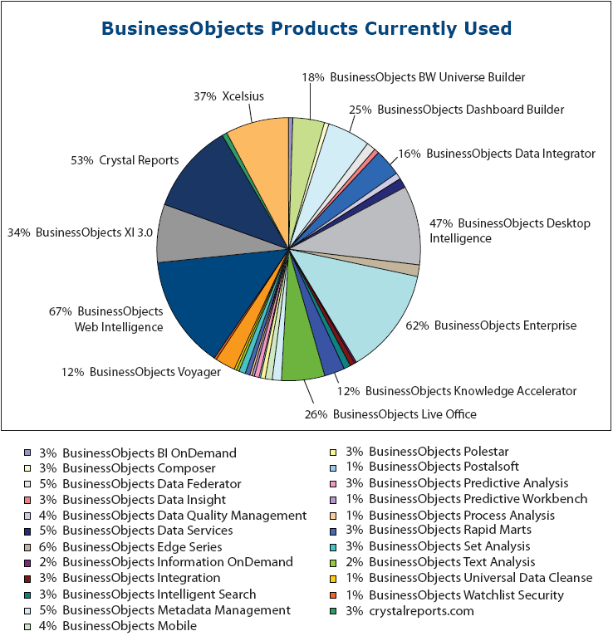

Slide 6
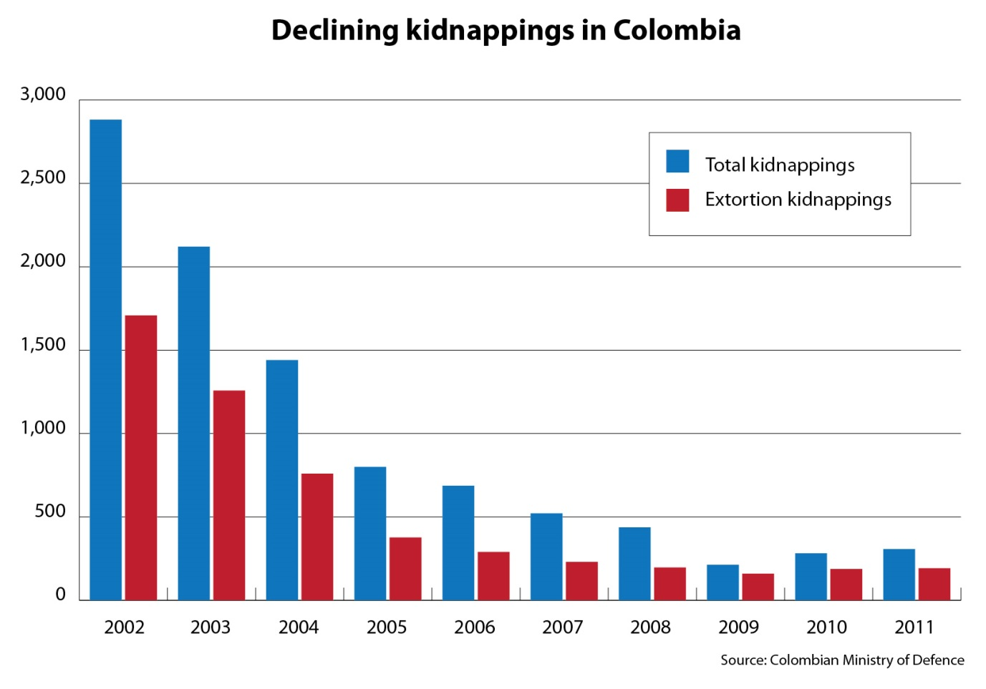

Slide 7
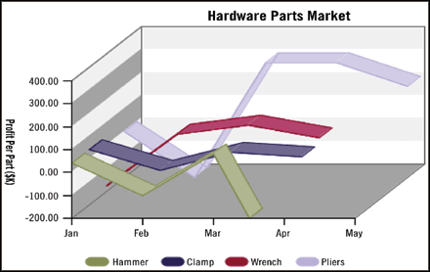

Slide 8
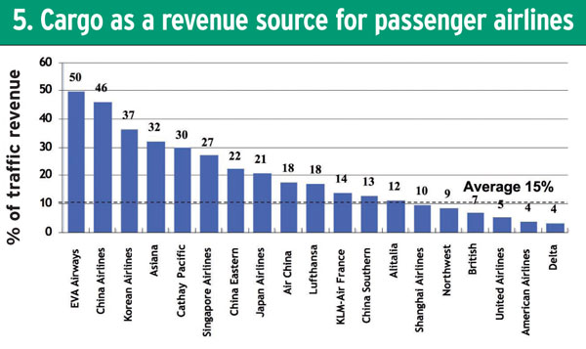

Slide 9
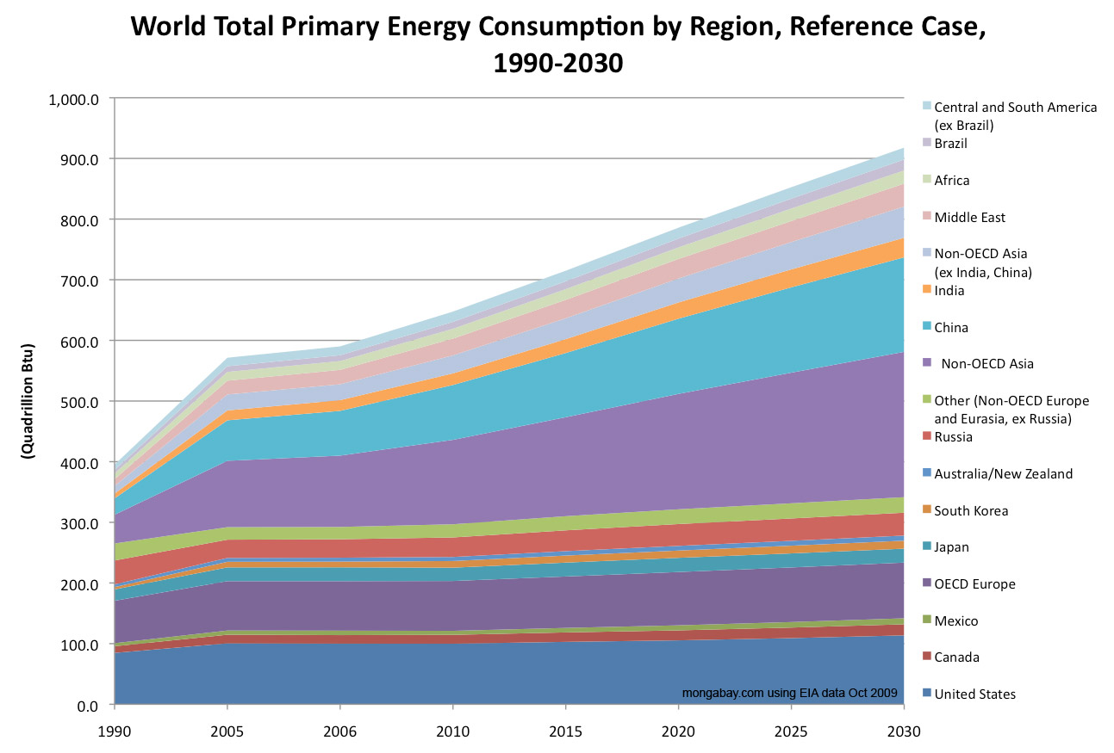

Slide 10
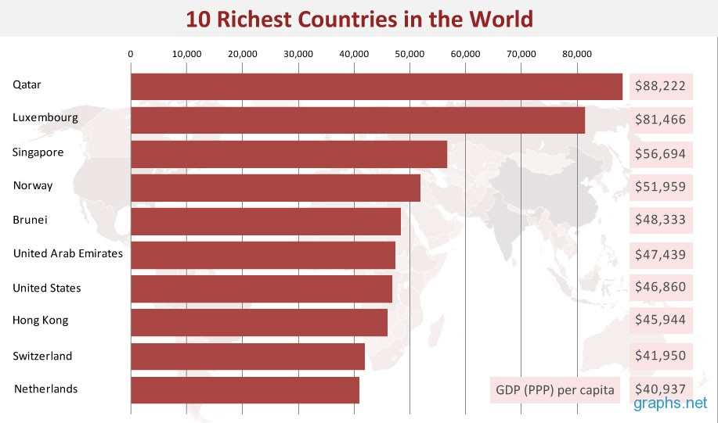

Slide 11
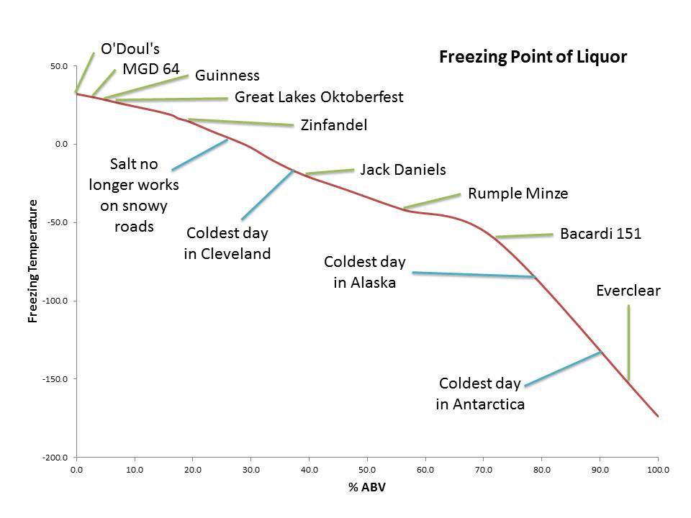

Slide 12
Histograms
Used for looking at one quantitative variable
Dataset of 434 workers
Age in years
Education
Current Salary
Gender
Job type

Slide 13
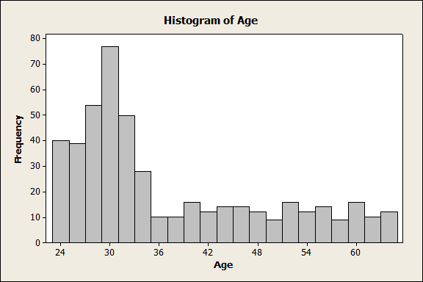
Age along the x-axis
Frequency – y-axis
Width the same
Height - frequency
Shows us the distribution of the variable age
Do the values look OK?
You can change the width of the bars and this can change the shape

Slide 14
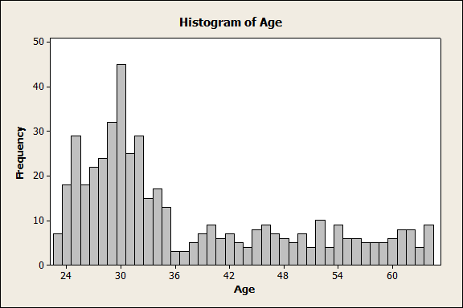

Slide 15
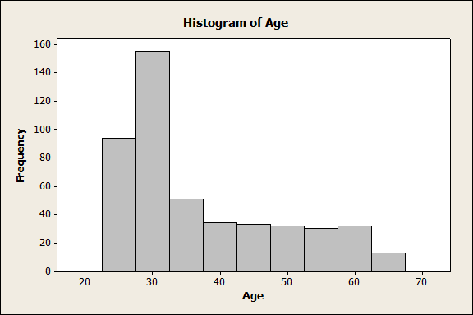

Slide 16
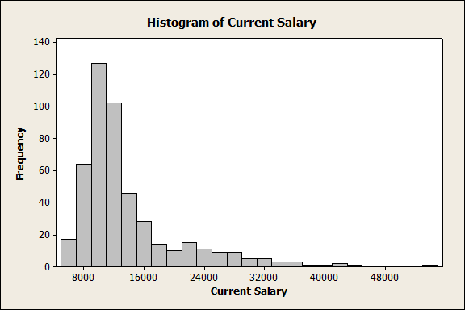
Another Histogram
Skewed

Slide 17
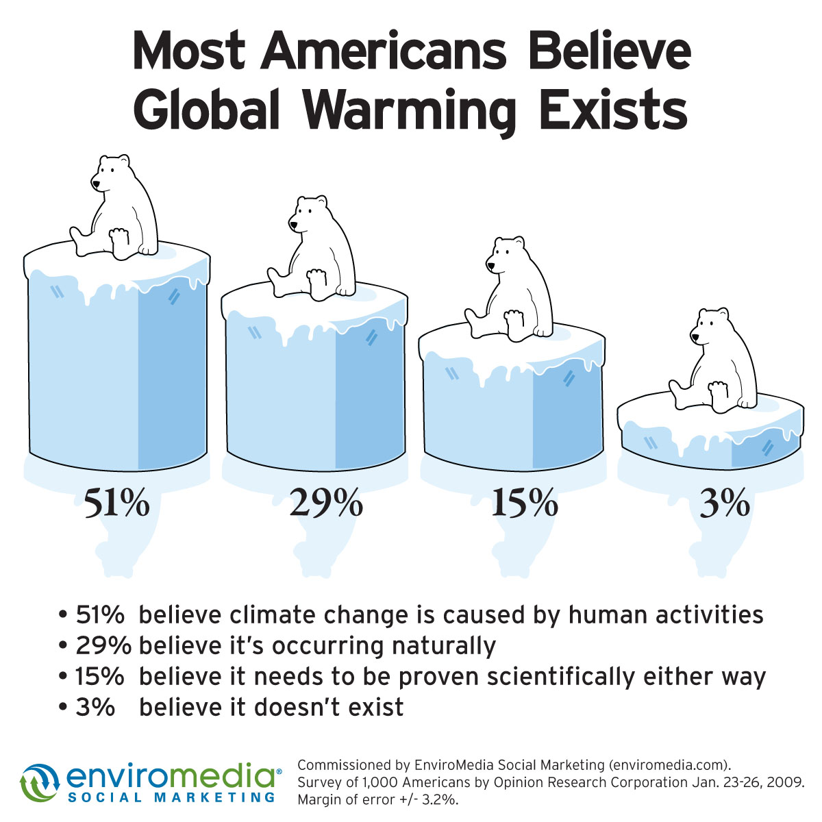

Slide 18
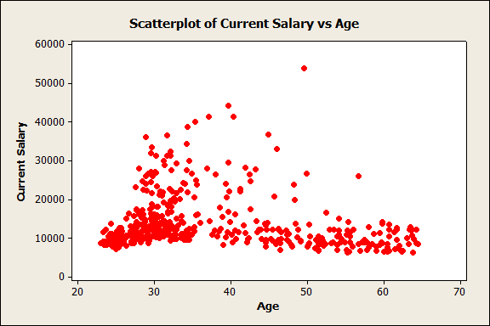
Scatterplot – 2 quantitative variables

Slide 19
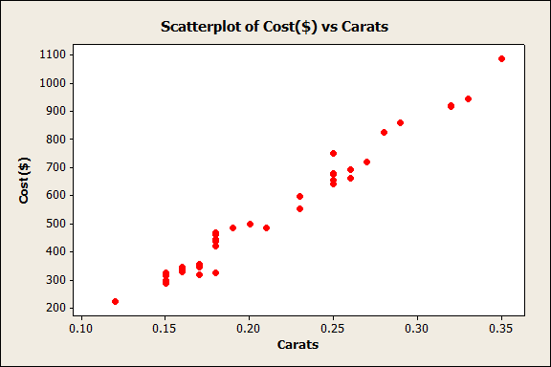
Price of diamonds v number of carats

Slide 20
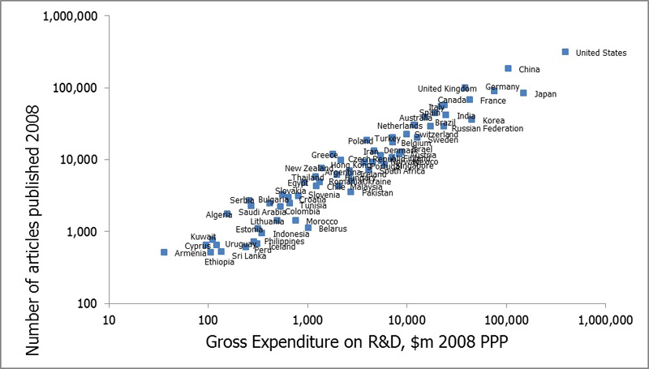

Slide 21
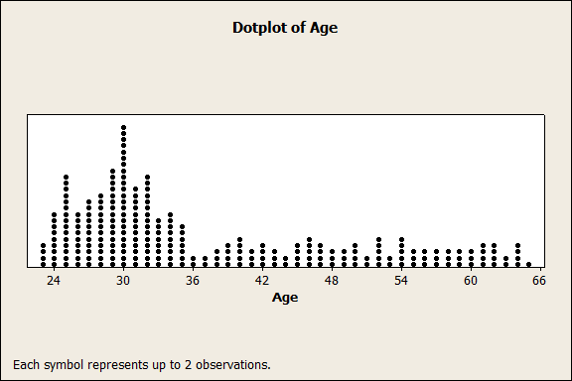
A dotplot

Slide 22
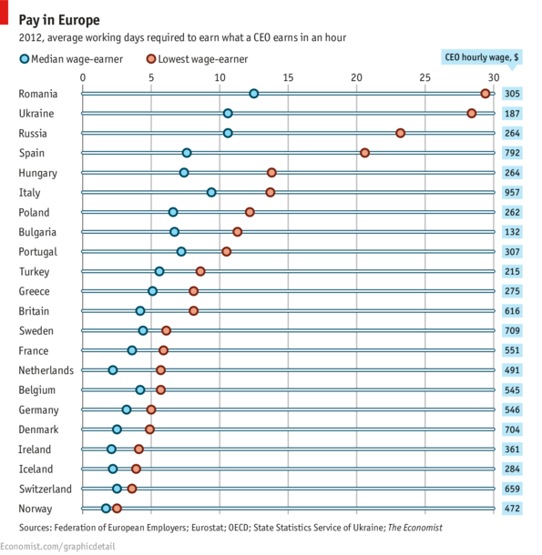

Slide 23
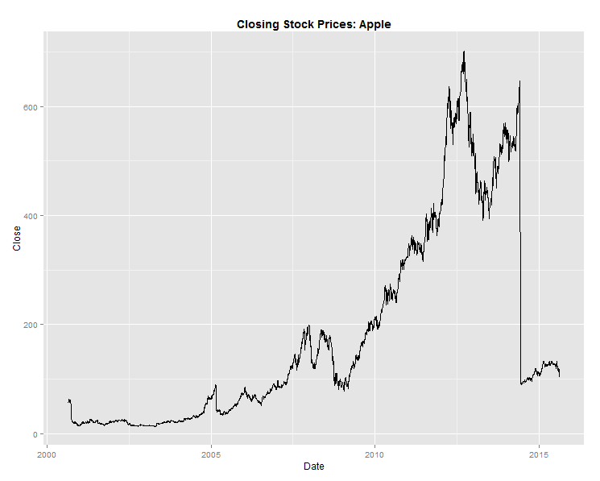
Plots over time

Slide 24
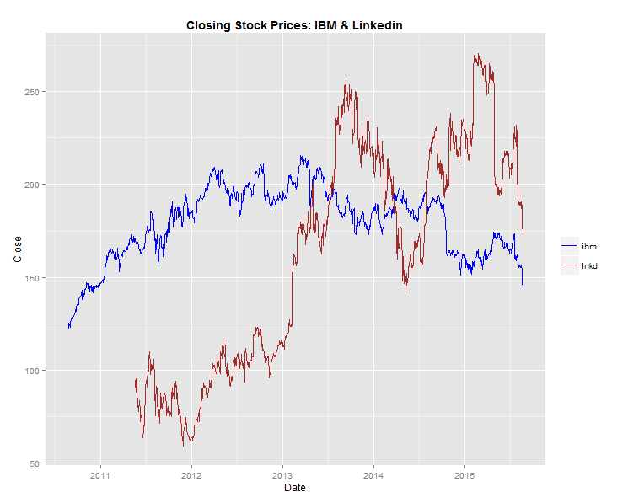

Slide 25
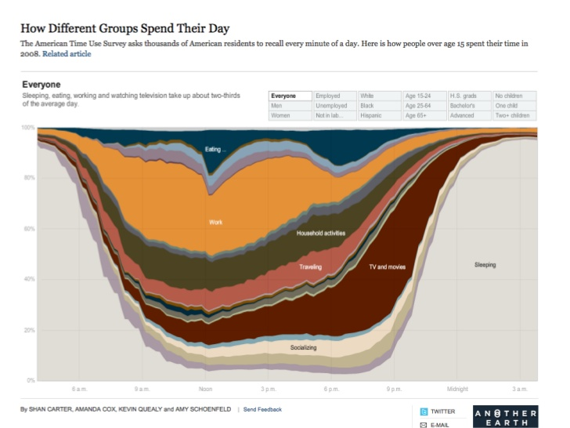

Slide 26
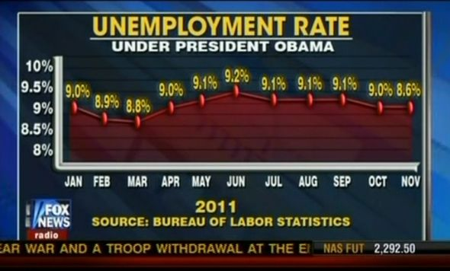
Can you spot any issues with the presentation of the graph?

Slide 27
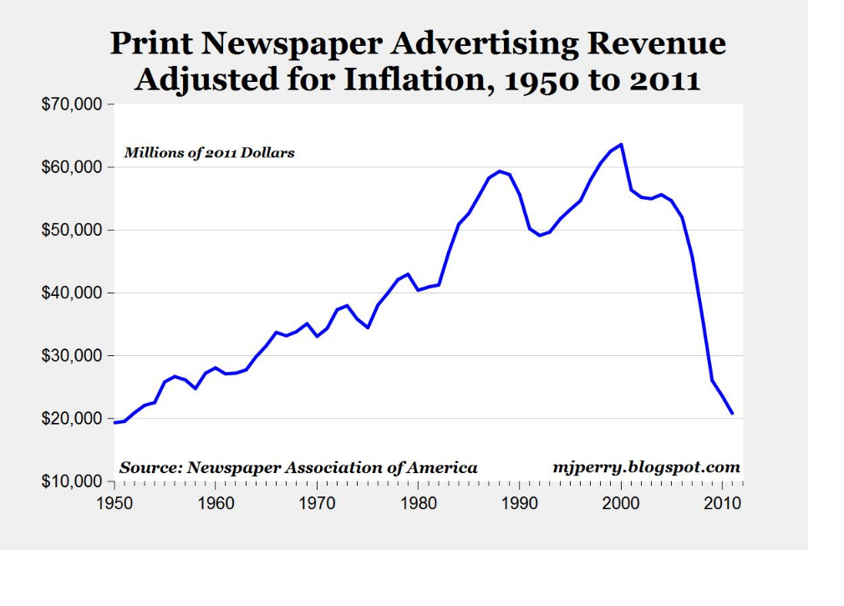

Slide 28
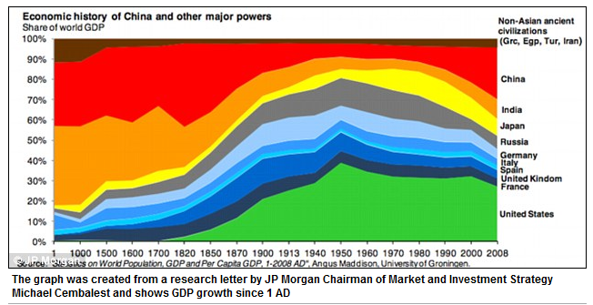

Slide 29
Categorical data
Tables of frequencies
Tally for Discrete Variables: Gender
Gender Count
Females 216
Males 258
N= 474

Slide 30
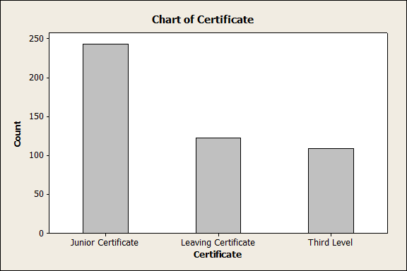
Bar Charts
Spaces between bars
Ordering here
Transpose it
Lots of other stuff here

Slide 31
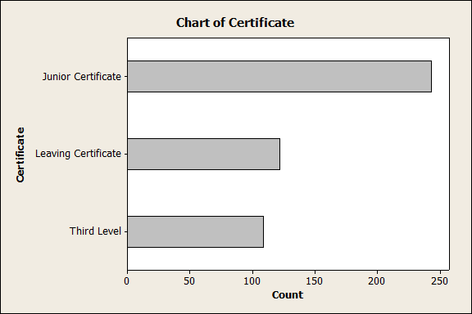

Slide 32
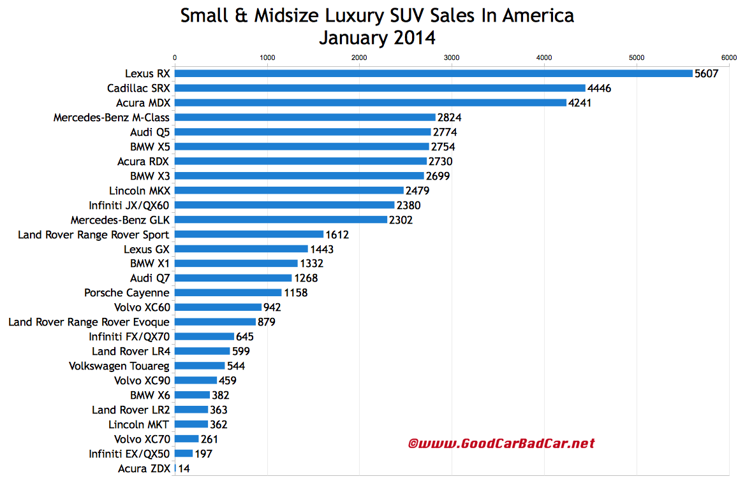

Slide 33
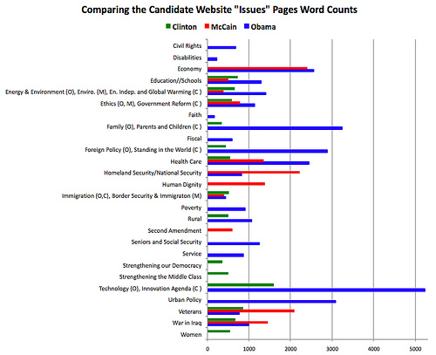

Slide 34
NO!!!
No 3 dimensional graphs please !!!!!!!!!!!!!!!!!

Slide 35
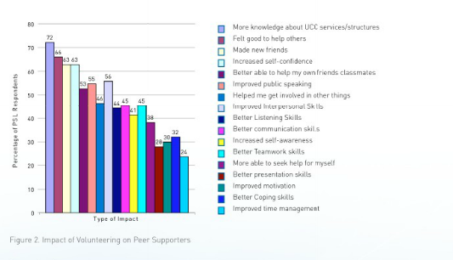
Another plot

Slide 36
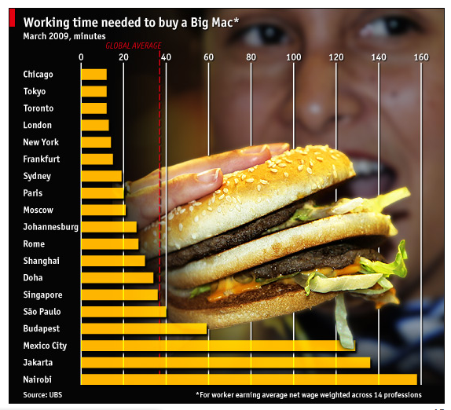

Slide 37
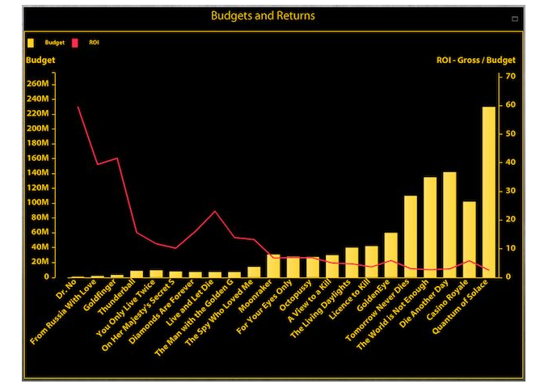

Slide 38
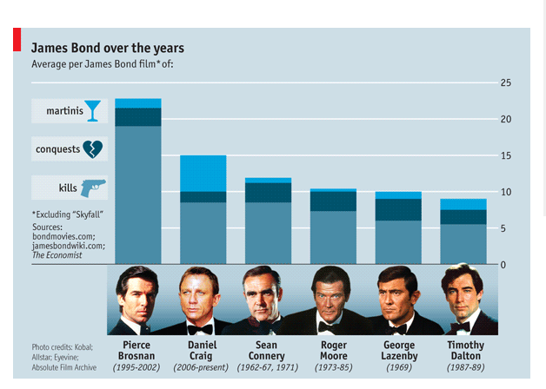

Slide 39
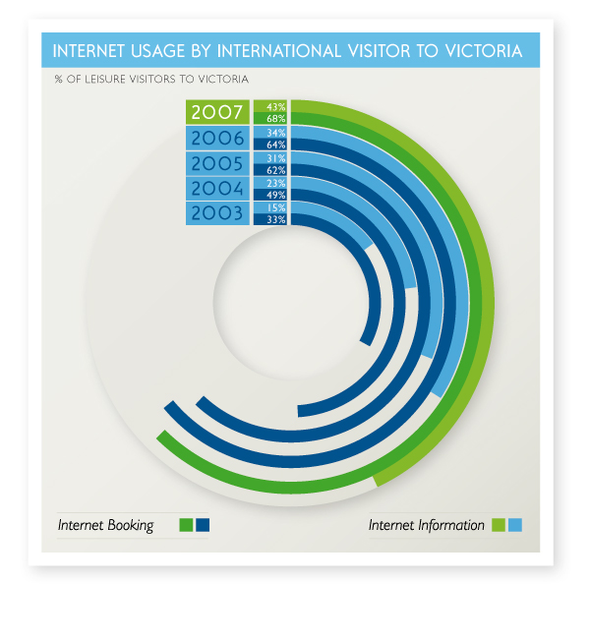

Slide 40
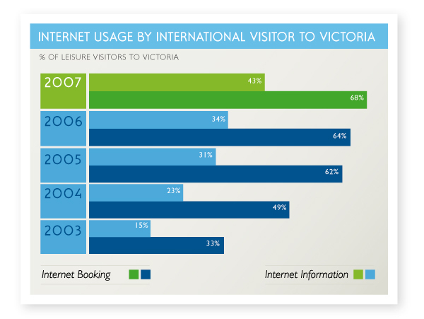

Slide 41
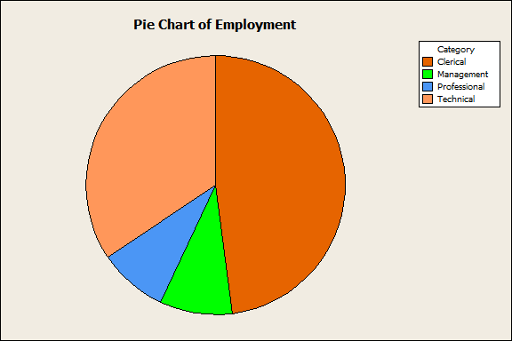
Piechart
Do not like this hard to judge sizes but people understand it.

Slide 42
No to these

Slide 43
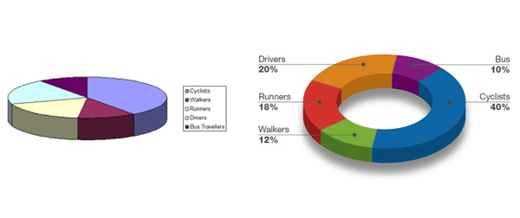

Slide 44
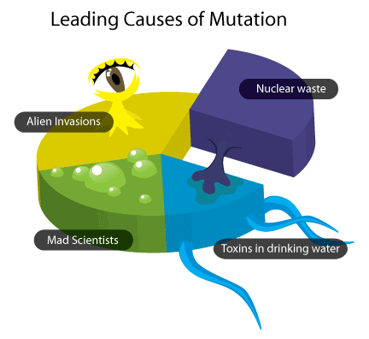

Slide 45
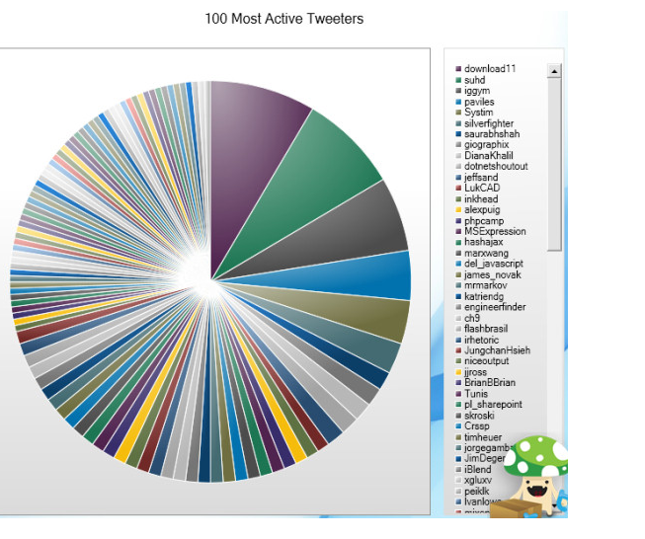

Slide 46
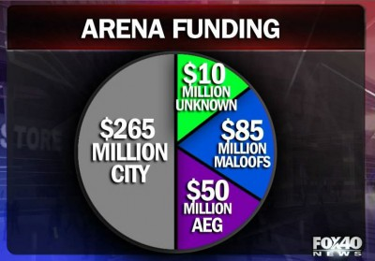

Slide 47
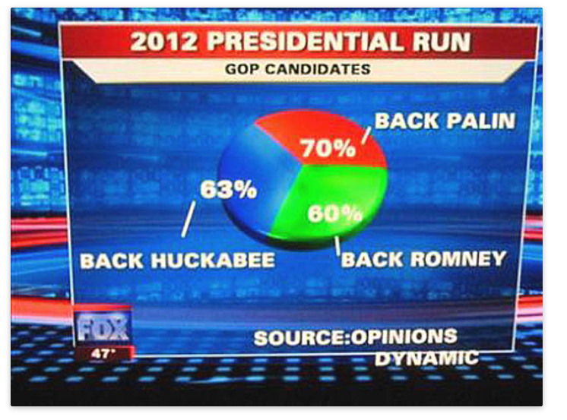

Slide 48
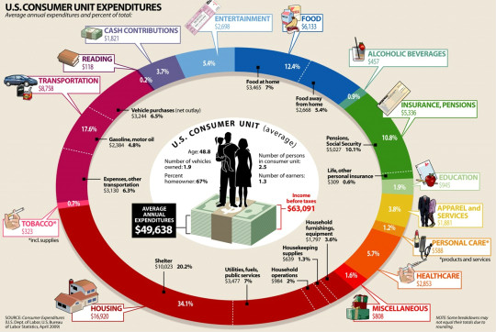

Slide 49
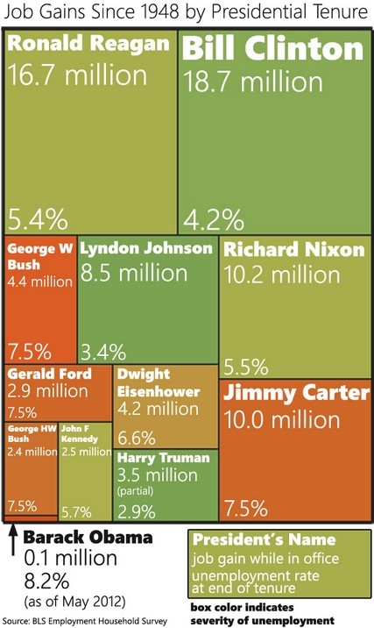

Slide 50
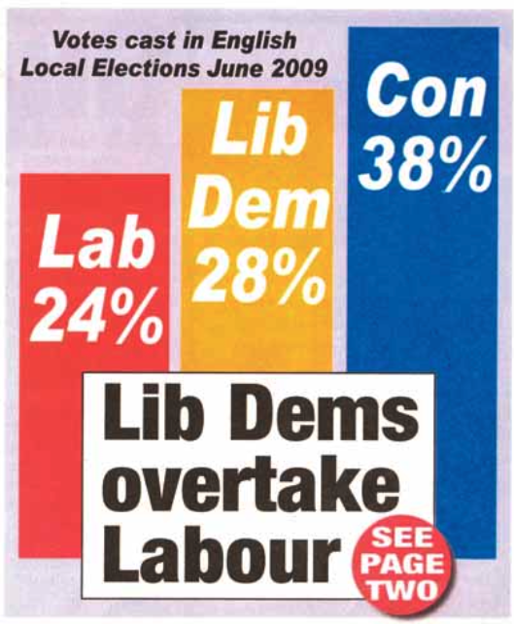

Slide 51
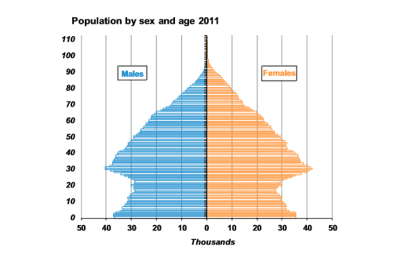

Slide 52
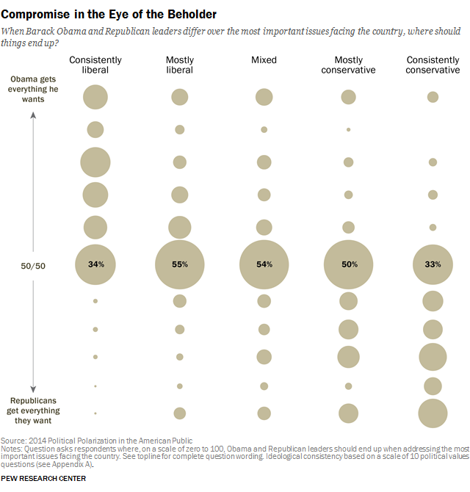

Slide 53
Summary Stats for Quantitative data
We have drawn the graphs
So what do we next?
We may want to summarise the data by using appropriate summary stats
Look at a couple of methods of doing this
A summary measure indicating a typical or centre value
Going to illustrate this with just 5 values
5 values 19, 54, 4, 10, 20

Slide 54
Measures of Centre
5 values 19, 54, 4, 10, 20
This is often called the average as well.
Very frequently used.

Slide 55
Another version …
Median
Sort the data from lowest to highest –
4,10,19,20,54
Pick middle one – 19
If you have got even number of points take the average
Half the observations are above the median and half below.

Slide 56
Something interesting …
5 values 19, 54, 4, 10, 20
What happens to mean and median if we change 20 to 200?
Mean becomes 57.4 and median becomes ???

Slide 57
Mean = ?? Median = ??
Notes:
Descriptive Statistics: Age, Current Salary
Variable N N* Mean SE Mean StDev Minimum Q1 Median
Age 474 0 37.186 0.541 11.787 23.000 28.480 32.000
Current Salary 474 0 13768 314 6830 6300 9600 11550
Variable Q3 Maximum
Age 46.043 64.500
Current Salary 14865 54000

Slide 58
Mean= ?? Median = ??
Notes:
Descriptive Statistics: REARN
Variable N N* Mean SE Mean StDev Minimum Q1 Median Q3
REARN 55729 170 37994 153 36137 1 17019 29914 46648
Variable Maximum
REARN 425510

Slide 59
Measures of spread
Range = value of highest – value of lowest = 54-4=50
Standard deviation(SD) quoted with mean
Variance = SD²

Slide 61
Standard deviation
1. Subtract each observation from the mean
2. Square the result
3. Sum over all the observations
4. Divide by the number of observations less 1 (n-1)
5. Take the square root.

Slide 62
Percentiles
75th Percentile(Q3) is the value below which 75% of the observations fall and 25% of the observations fall above
25th Percentile(Q1) is the value below which 25% of the observations fall and 75% of the observations fall above
Median = 50th percentile (Q2)
Interquartile range = 75th percentile(Q3) – 25th percentile(Q1)
Measure of spread quoted with median

Slide 63
Mode
Most frequently occurring value -
Competitions
Designing a new Banklink button

Slide 64
Other measures
Frequencies of the variable
Tell you something about how it is measured
Maximum value
Minimum value
% missing

Slide 65
Boxplots

Slide 66
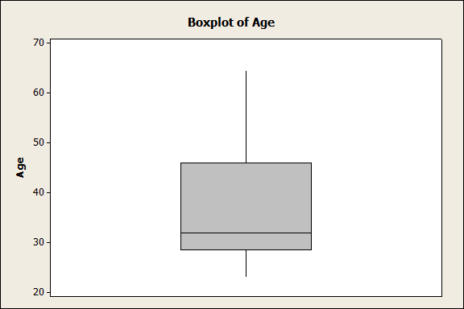

Slide 67
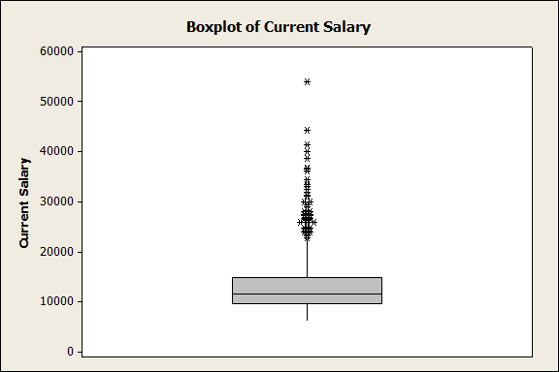
Outliers defined as anything above Q3 +1.5(Q3-Q1) or below Q1-1.5(Q3-Q1)

Slide 68
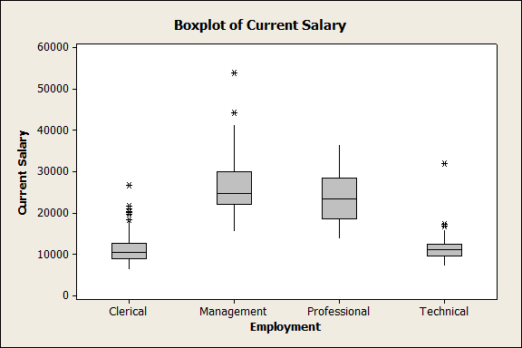
Really useful boxplot

Slide 69
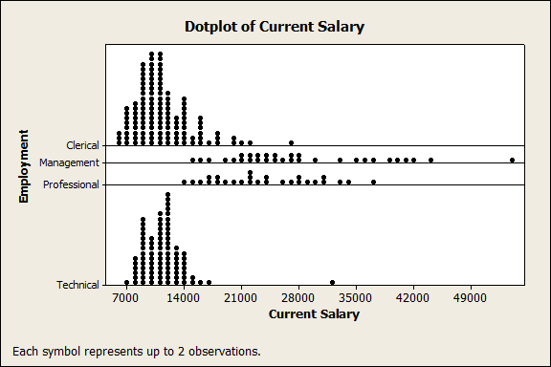
A dotplot version

Slide 70
Another way for Quantitative data
Age Category | Count | Percentage
<25 | 43 | 9.07
25-29 | 130 | 27.43
30-35 | 115 | 24.26
36-44 | 62 | 13.08
45-55 | 63 | 13.29
55+ | 61 | 12.87
Total | 474
What categories to use ?
Number of decimal places???

Slide 71
And again
Age Category | Count | Percentage
<25 | 43 | 9
25-29 | 130 | 27
30-35 | 115 | 24
36-44 | 62 | 13
45-55 | 63 | 13
55+ | 61 | 13
Total | 474

Slide 72
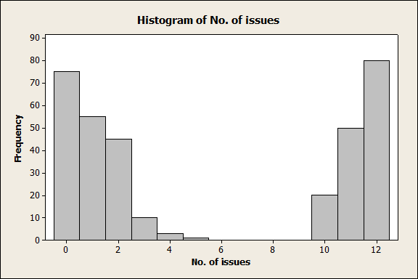
A little fun

Slide 73
And more info…
No. of
issues Count
0 75
1 55
2 45
3 10
4 3
5 1
10 20
11 50
12 80
N= 339
Notes:
Variable N N* Mean SE Mean StDev Minimum Q1 Median Q3
No. of issues 339 0 5.611 0.285 5.244 0.000 1.000 2.000 11.000
Variable Maximum
No. of issues 12.000

Slide 74
And a question
Suppose we rolled a fair dice 12,000 times what kind of result would you expect to get?
Draw a histogram.

Slide 75
Histogram

Slide 76
Results
Tally for Discrete Variables: C1
C1 Count Percent
1 1964 16.37
2 2028 16.90
3 1989 16.57
4 1981 16.51
5 1998 16.65
6 2040 17.00
N= 12000

Slide 77
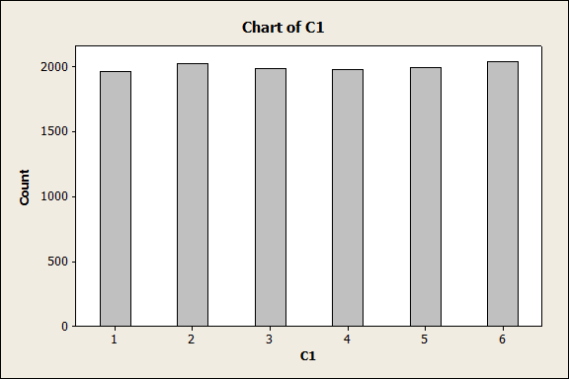

Slide 78
Your own examples
Look for your own examples in the newspapers or internet.
Document where you found it
Why you liked it?
Why you disliked it?

